Slide 1

Chapter 6 Logical Agents
In previous chapters
  agents solve problem by searching
  no knowledge (past experience) is used
  Humans solve problem
    by reusing knowledge and
    new facts concluded under reasoning of knowledge
    even under partially observable environment
  Reasoning is very important
    especially in the world where the results of actions are unknown

Slide 2

Knowledge-based agent
The central component of a KB agent
  its memory – knowledge base, or KB
  A KB is a set of representation of facts about the world
  Each of this representation is called a sentence
The sentences are expressed in a language called
  knowledge representation language
  (← syntax)

Slide 3
Design of knowledge-based agent
The state diagram, transition operators, search tree
  no longer applicable to build a KB agent
  because we don’t know the results
A new design (design of KB agent) includes:
  A formal language to express its knowledge
  A means of carrying out reasoning in this language
These two elements together constitute
  logic

Slide 4
Design of knowledge-based agent
TELL and ASK
  the way to add new sentences
  and the way to query what sentences the KB contains
Another main component of KB agent
  the inference engine
  This is to answer the query by ASK
    based on the sentences TELLed in the KB

Slide 5
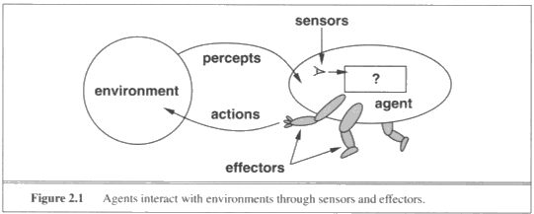
KB
Tell
Tell
KB
Ask
KB
Ask
Inference engine

Slide 6
Design of knowledge-based agent
The query
  may not be answered directly from the sentences
  but usually indirectly
At the initial stage of KB
  Before anything is TELLed
  It contains some background knowledge about the domain
  Example: location(desk, kitchen), …

Slide 7
How a KB performs
Each time the agent program is called, it does two things:
  it TELLs the KB what it perceives
  it ASKs the KB what action to perform
reasoning
  The process in concluding the action
    from the sentences in the KB
  This reasoning is done logically
  and the action found
    is proved to be better than all others
    (given the agent knows its goals)

Slide 8
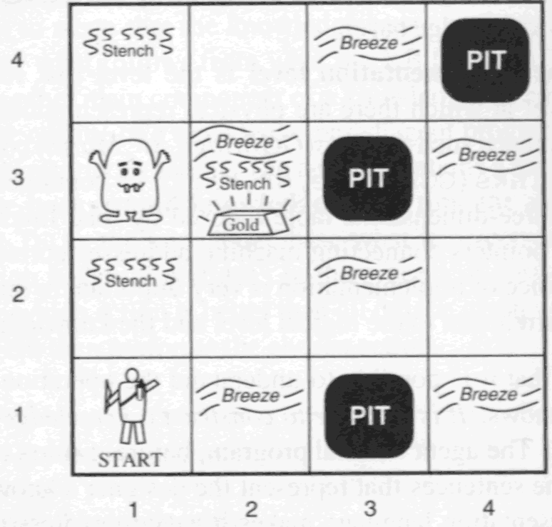
The WUMPUS world environment

Slide 9
PEAS description
Performance measure
  +1000 for picking up the gold
  -1000 falling into a pit, or being eaten by the wumpus
  -1 for each action taken
  -10 for using up the arrow

Slide 10
Environment
  A 4x4 grid of rooms.
  The agent always start in the square [1,1]
    facing to right
  locations of gold and wumpus
    chosen randomly uniformly
    from squares, except [1,1]
  pit
    every square, except [1,1], may be a pit
    with probability 0.2

Slide 11
Actuators (for the agent)
  move forward, turn left, turn right by 90º
    if there is wall, move forward has no effect
  dies if the agent
    enters a square with pit, or with a live wumpus
    it is safe to enter if the wumpus is dead
  Grab
    pick up an object that is in the same square
  Shoot
    fire an arrow in a straight line in the facing direction
    continues until it hits the wumpus, or a wall
    can be used only 1 time

Slide 12
Sensors – there are 5
  perceive a stench (臭味) if the agent is
    in the square with wumpus (live or dead)
    and in the directly adjacent squares
  perceive a breeze (風) if
    in the square directly adjacent to a pit
  perceive a glitter (耀眼)
    in the square containing the gold
  perceive a bump (撞)
    when walks into a wall
  perceive a scream (in all [x,y])
    when the wumpus was killed

Slide 13
The percept is then expressed
  as a state of five elements
  if in a square of stench and breeze only,
    the percept looks like
    [Stench, Breeze, None, None, None]
Restriction on the agent
  it cannot perceive the locations adjacent to itself
  but only its own location
  so it is a partially observable environment
  the actions are contingent (nondeterministic)

Slide 14
In most cases,
  the agent can retrieve the gold safely
About 21% of the environments,
  there is no way to succeed
Example,
  the squares around the gold are pits
  or the gold is in a square of pit

Slide 15
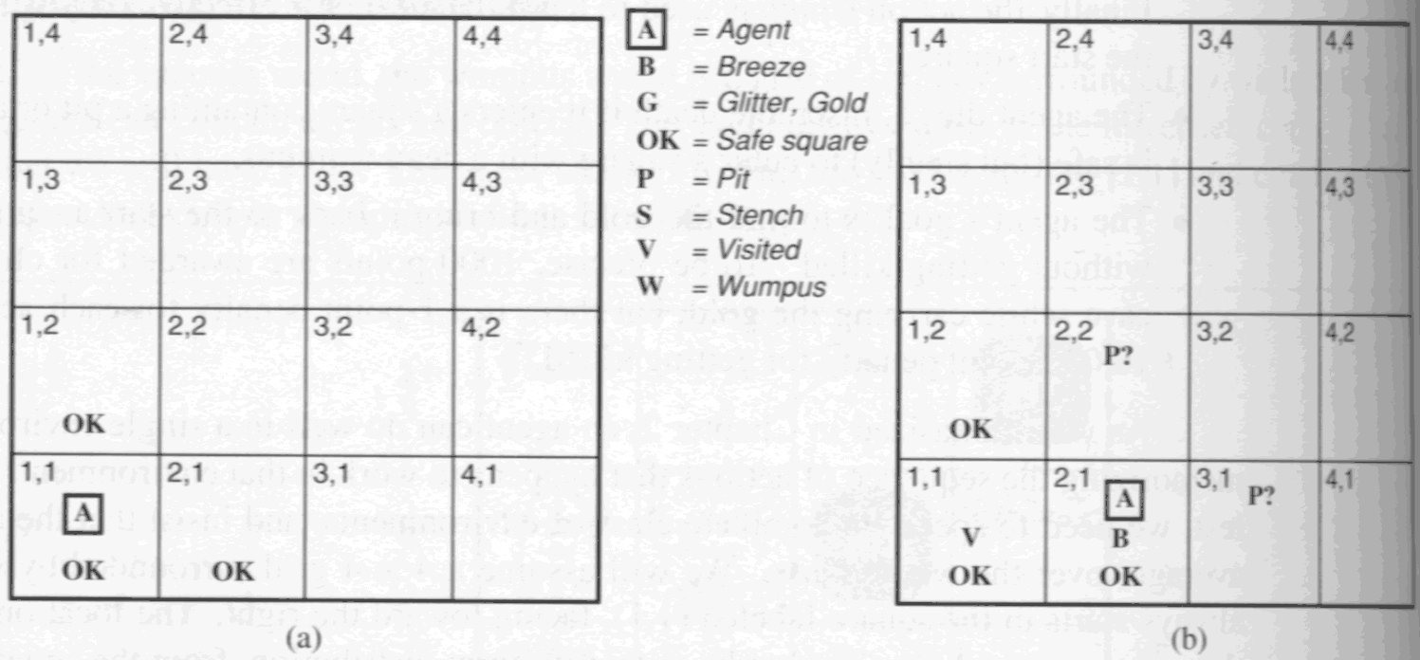
Based on the examples,
  thinking logically (rationally) can let the agent take the proven correct actions

Slide 16
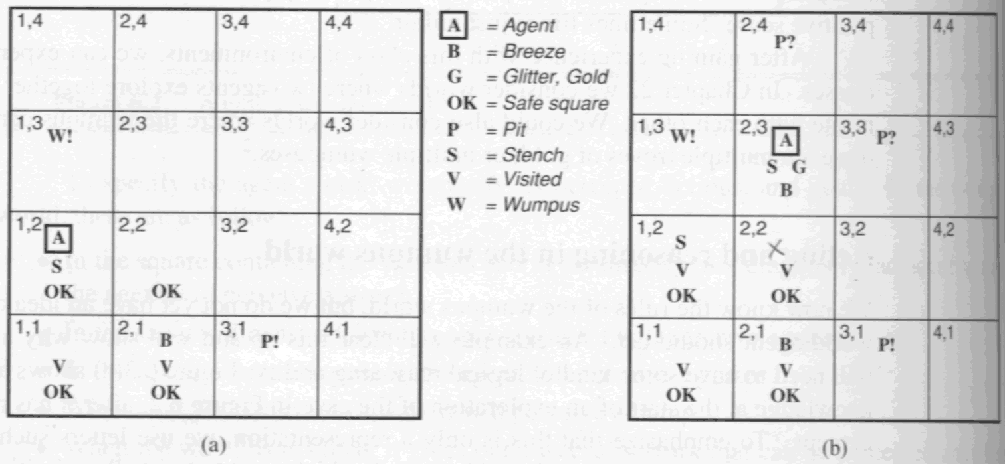

Slide 17
Propositional logic
The symbols of propositional logic are
  the logical constants True and False
  propositional symbols such as P and Q
  the logical connectives ∧,∨,⇒,⇔,¬, and ()
Sentences
  True and False are themselves sentences
  Propositional symbol such P and Q
    is itself a sentence
  Wrapping “( )” around a sentence
    yields a sentence

Slide 18
A sentence
  formed by combining sentences with one of the five logical connectives:
  ¬ : negation
  ∧ : conjunction
  ∨ : disjunction
  ⇒ : implication. P⇒Q : if P then Q
  ⇔ : bidirectional
An atomic sentence
  one containing only one symbol
Antecedent /
Premise
Conclusion /
Consequent

Slide 19
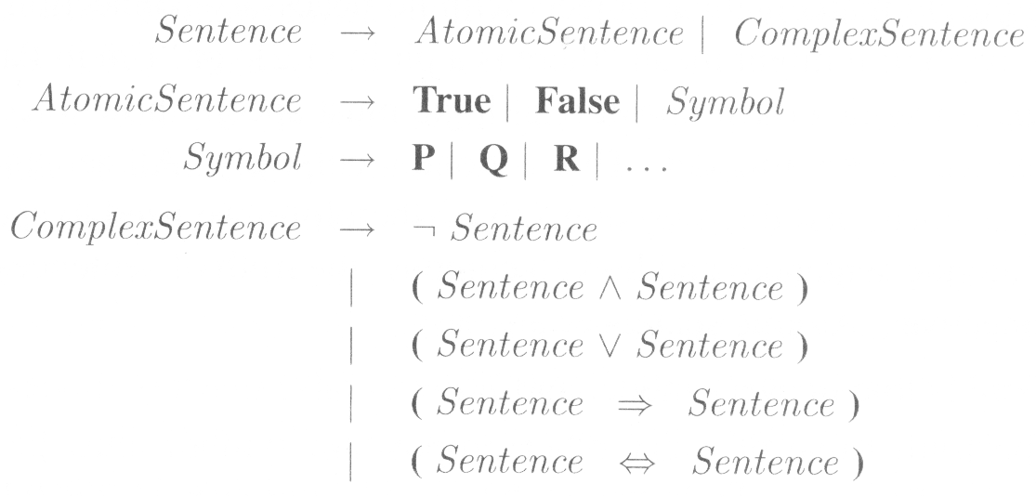
A literal
  either an atomic sentence
  or a negated one
A complex sentence
  sentences constructed from simpler sentences using logical connectors

Slide 20
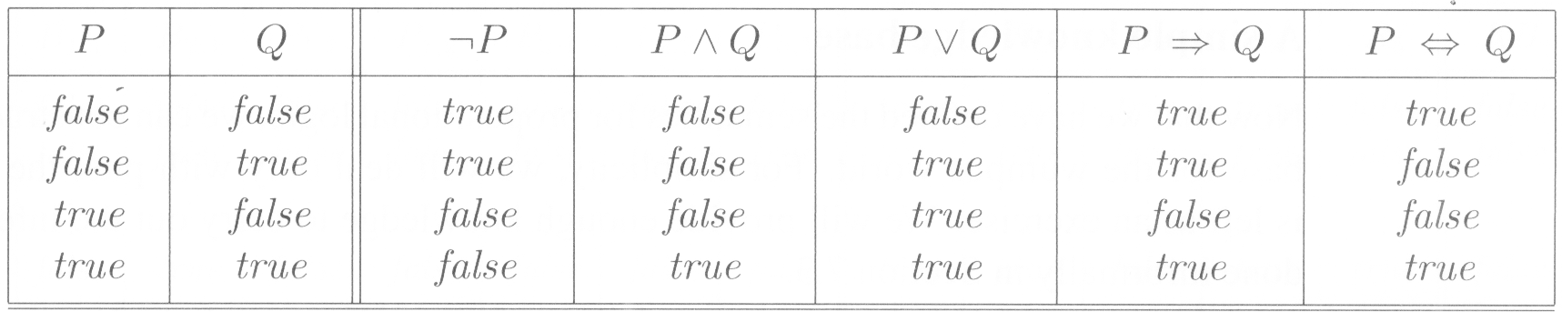
Semantics
The semantics of propositional logic
  simply interpretation of truth values to symbols
    assign True or False to the logical symbols
    e.g., a model m₁ = {P_{1,2} = false, P_{2,2} = false, P_{3,1} = true}
  the easiest way to summarize the models
    a truth table

Slide 21
A simple knowledge base
Use wumpus world as an example
  where only pits are defined
For each i, j:
  P_{i,j} = true if there is a pit in [i, j]
  B_{i,j} = true if there is a breeze in [i, j]
The knowledge base includes (rules)
  There is no pit in [1,1]
  R1 : ¬P_{1,1}

Slide 22
A square is breezy if and only if
  a pit in a neighboring square
  all squares must be stated
  now, just show several
Breeze percepts
  from the agent during runtime
Then the KB contains
  the five rules, R₁ to R₅
R2: B_{1,1} ⬄ (P_{1,2} ∨ P_{2,1})
R3: B_{2,1} ⬄ (P_{1,1} ∨P_{2,2} ∨P_{3,1})
R4 : ¬B_{1,1}
R5 : B_{2,1}

Slide 23
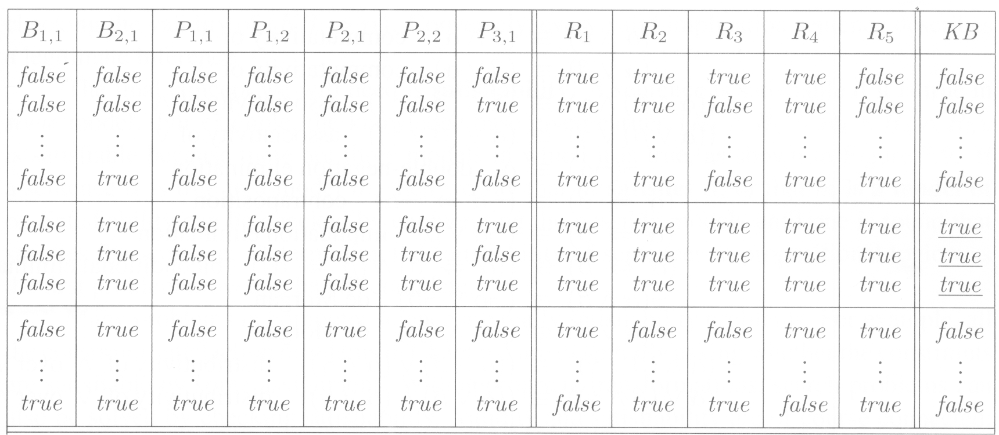
Inference
Based on the existing KB
  a set of facts or rules
  we ASK a query, e.g., is P_{2,2} true?
Inference is performed to give the answer
In this case, a truth table is used

Slide 24
For large KB,
  a large amount of memory necessary
    to maintain the truth table
  if there are n symbols in KB
    there are totally 2^{n} rows (models) in the truth table
    which is O(2^{n}), prohibited
  also the time required is not short
  so, we use some rules for inference
    instead of using truth tables

Slide 25
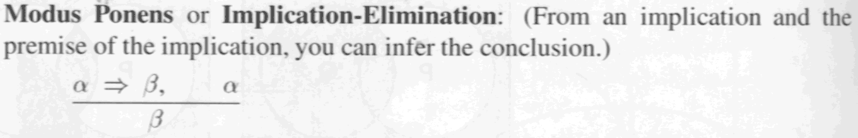
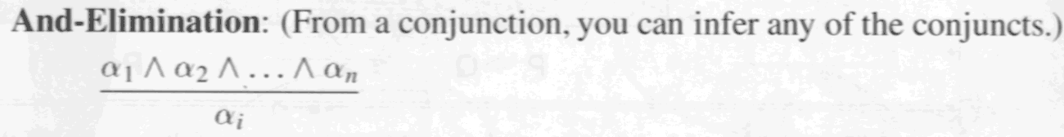
Reasoning patterns propositional logic
An inference rule
  a rule capturing a certain pattern of inference
  To say β is derived from α
  we write α├ β or
List of inference rules
α
β

Slide 26
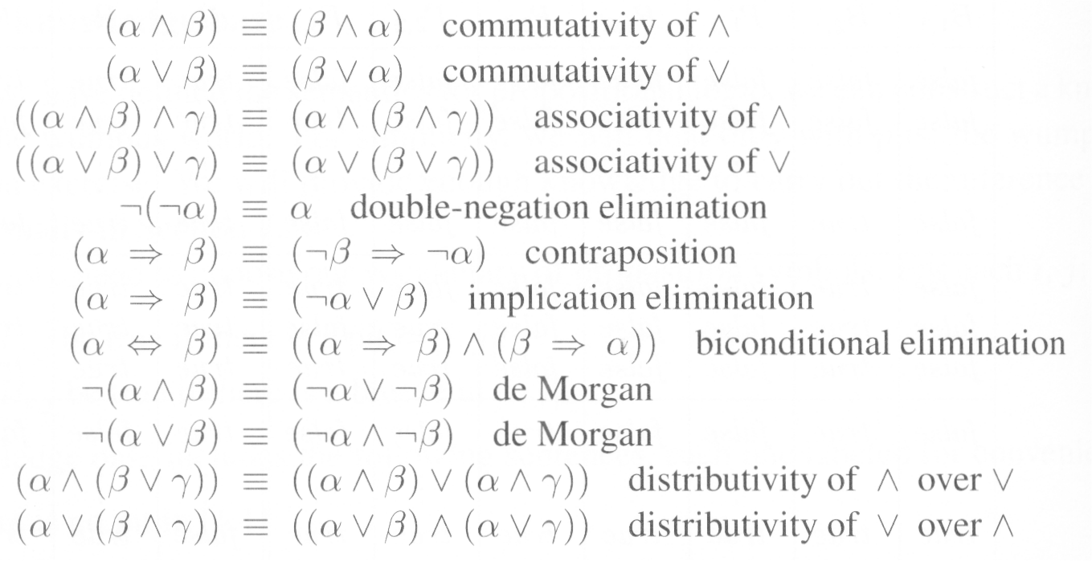
All logical equivalences in the following
  can be used as inference rules

Slide 27
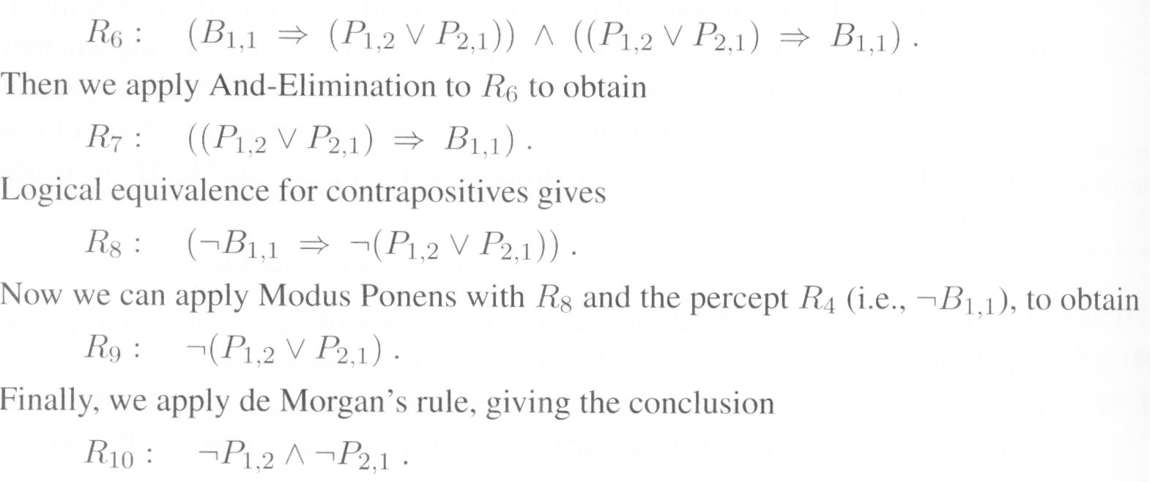
We start with R₁ through R₅ and show how to prove
  no pit in [1,2]
  From R₂, apply biconditional elimination

Slide 28
The preceding deviation – called a proof
  a sequence of applications of inference rules
  similar to searching a solution path
    every node is viewed as a sentence
    we are going to find the goal sentence
  hence all algorithms in Ch.3 and Ch.4 can be used
  but it is proved to be NP-complete
    an enormous search tree of sentences can be generated exponentially

Slide 29
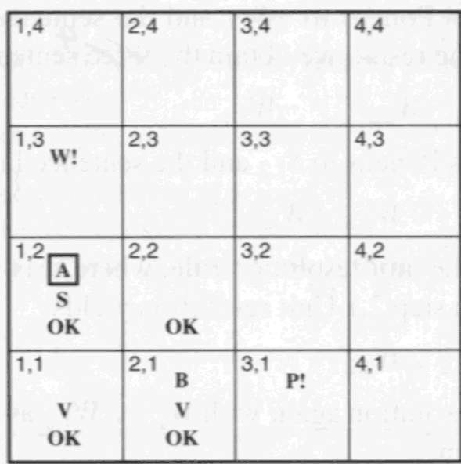
Resolution
This is a complete inference algorithm
  derive all true conclusions from a set of premises
  Consider it →
  Agent
    returns from [2,1] to [1,1]
    then goes to [1,2]
    Perception?
      stench
      no breeze
    All these facts
      added to KB

Slide 30
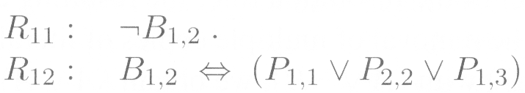
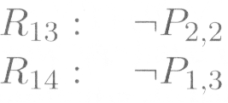



Similarly to getting R₁₀, we know
Apply biconditional elimination to R₃, then M.P. with R₅, then
Then apply resolution rule: ¬P_{2,2} in R₁₃ resolves with P_{2,2} in R₁₅
We know ¬P_{1,1} is not pit:

Slide 31
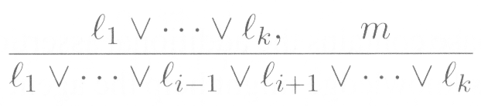
The previous rules are unit resolution
  where l and m are complementary literals
  m = ¬l
  the left is called a clause
    a disjunction of literals
    where the left one is called a unit clause
For full resolution rule

Slide 32
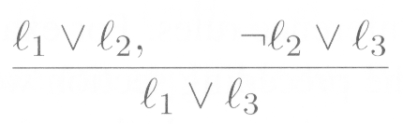
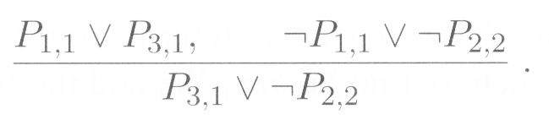
Two more examples for resolution
One more technical aspect in resolution
  factoring – removal of multiple copies
  e.g., resolve (A ∨ B) with (A ∨ ¬B)
  generate (A ∨ A) = A

Slide 33
Conjunctive Normal Form
Resolution rule – a weak point
  applied only to disjunctions of literals
  but most sentences are conjunctive
  so we transform the sentences in CNF
    i.e., expressed as a conjunction of disjunctions of literals
  a sentence in k-CNF has k literals per clause
  (l_{1,1} ∨ … ∨ l_{1,k}) ∧ … ∧ (l_{n,1} ∨ … ∨ l_{n,k})

Slide 34
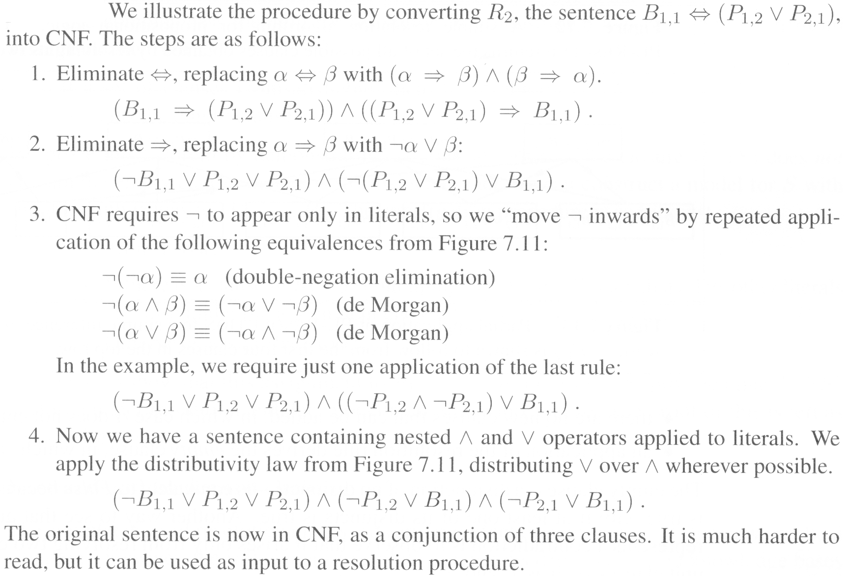
Conversion procedure

Slide 35
Resolution algorithm
Inference based on resolution
  proof by contradiction, or refutation
  i.e., show (KB ∧ ¬ α ) is unsatisfiable
  e.g., To prove α, first assume ¬ α, to see the result can be true or not.
    True → ¬ α = True, False → α = True
The first step, all sentences
  (KB ∧ ¬ α ) are converted into CNF
  Then apply resolution rules to this CNF
    then see which result it is

Slide 36
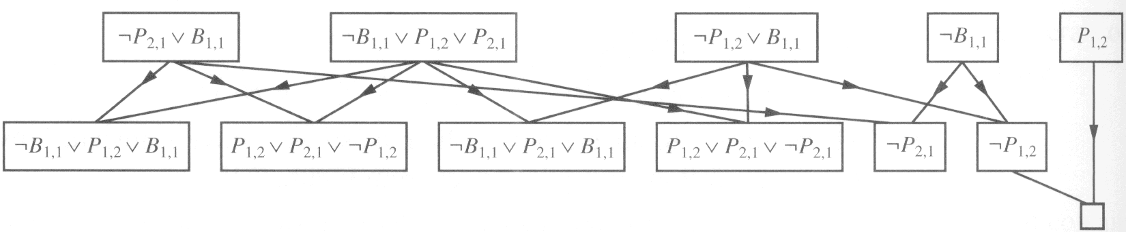

Slide 37
Forward and backward chaining
In many practical situations,
  resolution is not needed
  reason?
    real-world KB only has Horn clauses
    a disjunction of literals of which
      at most one is positive
    e.g., ¬ L_{1,1} ∨ ¬Breeze ∨ B_{1,1}
    ¬ B_{1,1} ∨ P_{1,2} ∨ P_{2,1} is not
  why only 1 positive literal?

Slide 38
Three reasons
  1. Horn clause → implication
    premise = conjunction of positive literals
    and conclusion = a single positive literal
    e.g., (L_{1,1} ∧ Breeze) => B_{1,1}
    a Horn clause with no positive literals
      (A ∧ B) => false
  2. Inference with Horn clauses
    work with Forward and Backward chaining
    both of them
      an easy and natural algorithm

Slide 39
  3. Reasoning with Horn clauses
    work in time linear in the size of KB
    cheap for many propositional KB in practice
Forward chaining
  to produce new information
    based on the set of known facts and clauses
    the new information will then be added to KB
    and produce another set of information
  e.g.,
(L_{1,1} ∧ Breeze) => B_{1,1}
L_{1,1}
Breeze
Then? B_{1,1} is added

Slide 40
When we want to prove q or find q
Using forward-chaining
  producing new fact continues until
    the query q is added
    no new facts can be generated
  this process runs in linear time
This kind of inference
  called data-driven
  inference starts with the known data
    i.e., clauses (rules) are driven with data

Slide 41
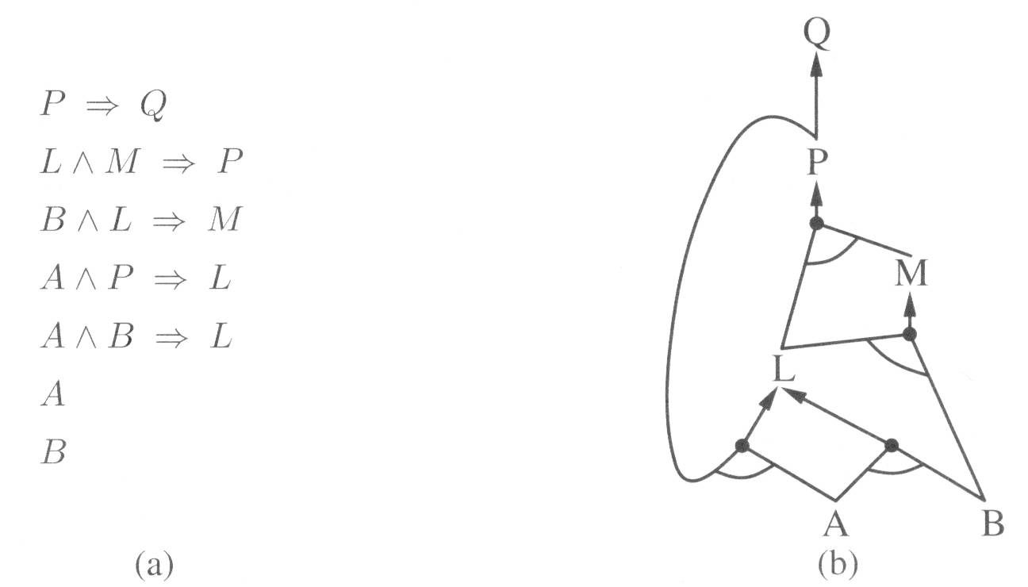
AND-OR graph
  conjunction -- multiple links with an arc indication
  disjunction -- multiple links without an arc indication

Slide 42
Backward chaining
  the opposite of forward chaining
  A query q is asked
    if it is known already, finished
    otherwise, the algorithm finds all implications that conclude q (the clauses with q as head)
    try to prove all premises in those matched implications
    every premise is then another query q’
  what is that?
    Prolog matching and unification
    also runs in linear time or fewer than linear time
      only relevant clauses are matched and used

Slide 43


Agents based on Propositional Logic
Finding pits and wumpuses, for every [x,y]
  rule for breeze
  rule for stench
  rules for wumpus
    at least one wumpus: W_{1,1} ∨ W_{1,2} ∨ … ∨ W_{4,4}
    and at most one wumpus
      for any two squares, one of them must be wumpus-free
      with n squares, how many sentences? n(n-1)/2
      e.g., ¬ W_{1,1} ∨ ¬ W_{1,2}
      for a 4 x 4 world, there are 105 sentences containing 64 distinct symbols. (each square has S, B, W, P, …)

Slide 44

Keeping track of location & orientation
for every square, the player
  may face 4 different orientation
  Up, Down, Left, Right
  in order to let the player forward
    hence the rules are increased to 4 times
    this greatly affect the efficiency
      because too many rules !!

Slide 45
It still works in small domain (4 x 4)
  how about (10 x 10)? and even (100 x 100)?
The main problem
  there are too many distinct propositions to handle
The weakness of Propositional Logic
  lack of expressiveness
  every similar variable must be listed out!!
  we need another powerful device
    First-order logic – discussed in chapter 8

